Slide 1
Extending Scenic to Generate Three-Dimensional Meshes of Road Networks
Ethan Makishima

Slide 2
Context
Motivation:
Scenic is a domain-specific probabilistic programming language for modeling the environments of cyber-physical systems like self-driving cars
Useful for testing autonomous vehicle software on rare/edge cases
Currently, Scenic only supports generating two-dimensional road networks
So overpasses, hills, tunnels, etc. are not able to generate properly
Notes:
Talk about problems with 2D and why 3D would solve those problems

Slide 3
Goal
Extend Scenic’s codebase to be able to parse elements with elevation
Modify the calculations to fit three-dimensions
Generate three-dimensional meshes
Run simple tests with the generated three-dimensional road networks

Slide 4
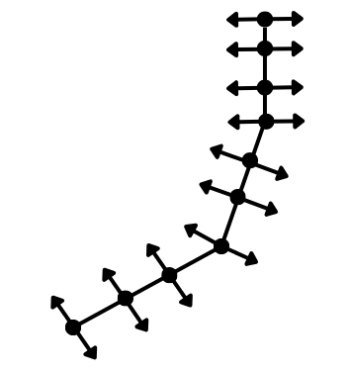
Problem Definition
Previous 2D implementation:
Scenic parses OpenDrive (XODR) files to extract the road elements
The parser generates reference points along the centerline of the road
Generates the road outward toward its left and right bounds to get the points
Create the road polygon using these points
Notes:
Diagram to illustrate, break into a couple of slides, or make the bullet points appear one by one to make more digestible. Explain the union a bit more, talk about why we want a separate road and also the bigger structure. Polyline are the boundaries of the road.

Slide 5
Problem Definition
Create Scenic object by aggregating all the data (shape, dimensions, etc.) into one object
The polygon represents the geometry of the road
The centerline, left bound, and right bound lines are represented by Regions
Regions: a class that defines a geometric space in Scenic
Polyline region: one or more two-dimensional lines

Slide 6
Problem Definition
Scenic needs a single polygon for all the categories of elements (roads, shoulders, etc.)
Use buffer union, a function that combines polygons together into one shape
The ‘buffer’ closes small gaps in-between polygons
Pass in the combined mesh as a Polygonal Region
Polygonal Region: Scenic geometric space defining one or more polygons

Slide 7
Problem Definition
Convert to 3D implementation:
Points, such as ref points, need to have z coordinates
Polygons are replaced by meshes
Functions specific to polygons need to be replaced
Polyline region objects -> Path region objects
Polygonal region objects -> Mesh surface region objects

Slide 8
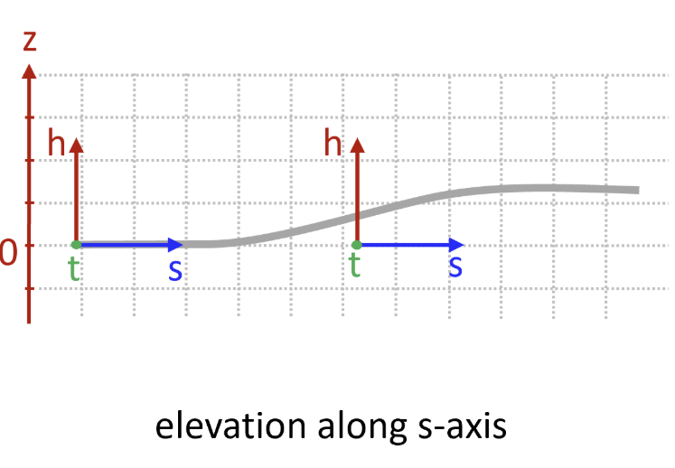
Parsing File
The parser takes an OpenDrive (XODR) file and gets all the elements and properties
Need to parse the <elevationProfile> element to get the <elevation> values
Each <elevation> contains the doubles <s, a, b, c, d>
Equation: elev(ds) = a + b*ds + c*ds² + d*ds³
ds = distance along the road reference line
Plug this into the z-coordinate of the reference points
Change all point variables to include a z-coordinate
Notes:
Animate to have points. Add open drive picture.

Slide 9
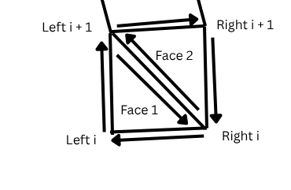
Calculating the and geometry
Build meshes in place of the polygons
Use Trimesh Library
For each left and right bounds and reference point i, build two faces for the mesh
Face 1: left i to left i + 1 to right i
Face 2: right i to left i + 1 to right i + 1
Use concatenation function to get the full road mesh
Concatenation: Trimesh function to combine meshes into one single mesh
Notes:
Add a picture of the trimesh mesh.

Slide 10
Converting Roads into Scenic Network Elements
‘NetworkElement’: A class that is an aggregation of shape, dimensions, and other attributes that define Scenic object.
Roads, lanes, shoulder, and sidewalks all fall under this class
Pass in a mesh instead of a polygon for its geometry
Pass in path regions instead of polyline regions for the centerline, left edge, and right edge.
Path region: A region consisting of multiple polylines in 3D space
For the forward and backward lane groups, passing in the concatenated trimesh of either all the forward and backward lane groups for the geometry

Slide 11
Converting RoadMap into Scenic Network
Scenic needs a single region for all the categories of elements (roads, shoulders, etc.)
Concatenate roads, shoulders, and sidewalks into three separate meshes
Scenic also needs intersection region
Use existing intersection calculation and concatenate the meshes instead of using buffer union
(Might yield intersecting meshes, can cause problems)
Use Mesh Surface Region to represent the combined regions
Mesh Surface Region: a region representing the surface of a mesh

Slide 12
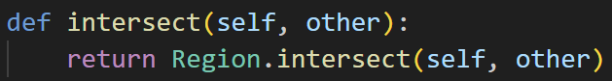
Challenges
Main Challenge: lots of the code is built around two dimensions
Network Element class:
Originally a subclass of Polygonal Region, but need to also work with Mesh Surface Region
Redesigned Network Element to be a subclass of Region (abstract class)
Created new versions of functions from the region classes that call upon either Polygonal Region or Mesh Surface Region
Notes:
Explain the region class, show a snippet of code of the Region.----()

Slide 13
Challenges
R-tree implementation:
The network uses the R-tree, a tree data structure to store geometrical objects
Useful for Scenic as it can query a large number of objects quickly
Used a function from the Shapely library to build an R-tree with all of the polygons
We take the meshes from the network, convert them into Mesh Surface Regions, and call the function for bounding polygon
Bounding Polygon: which creates a polygon along the x and y coordinates of the mesh and
Put polygons into same Shapely function to build the R-tree
Notes:
Turn on slide numbers, context for the R-tree and what is used for, say it earlier. R-tree can be used to lookup a big dataset of geometries. Maybe not talk about the findPointWithin function.

Slide 14
Results/Demo
The meshes are rough, but the general shape and size of the maps is accurate
Able to properly generate the correct z-coordinates
Able to generate a visualization of these meshes
Running a simple Scenic script, we can not only show that vehicles can generate on the three-dimensional roads, but also that they generate properly on the correct z-coordinate relative to the road
Notes:
Show a snippet of code

Slide 15
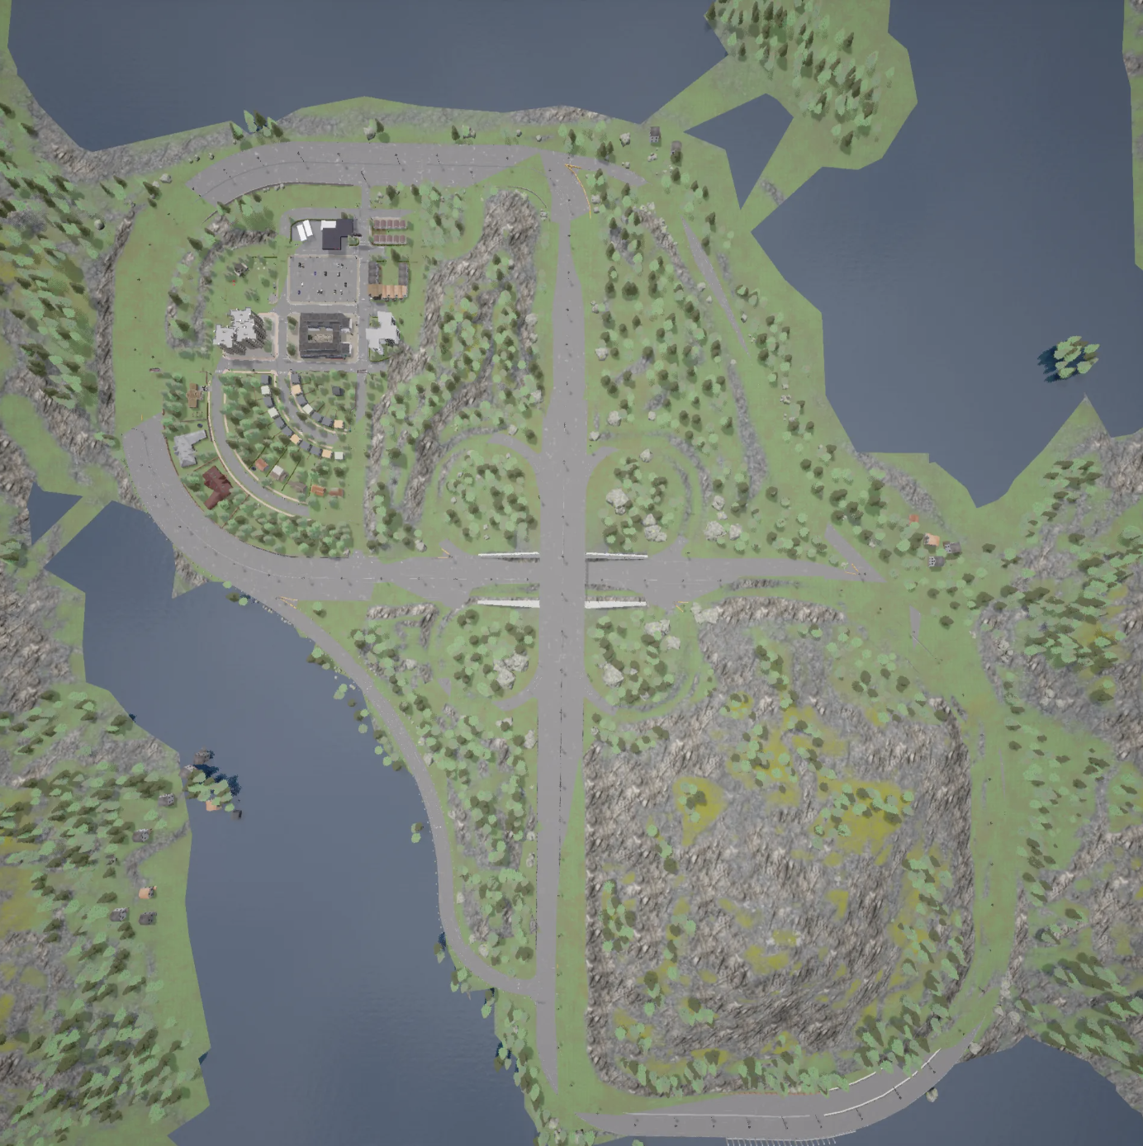
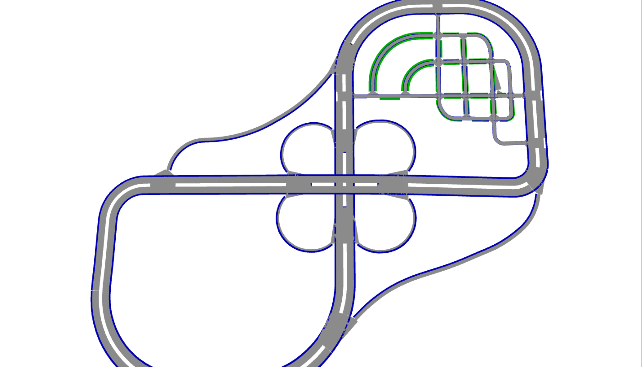
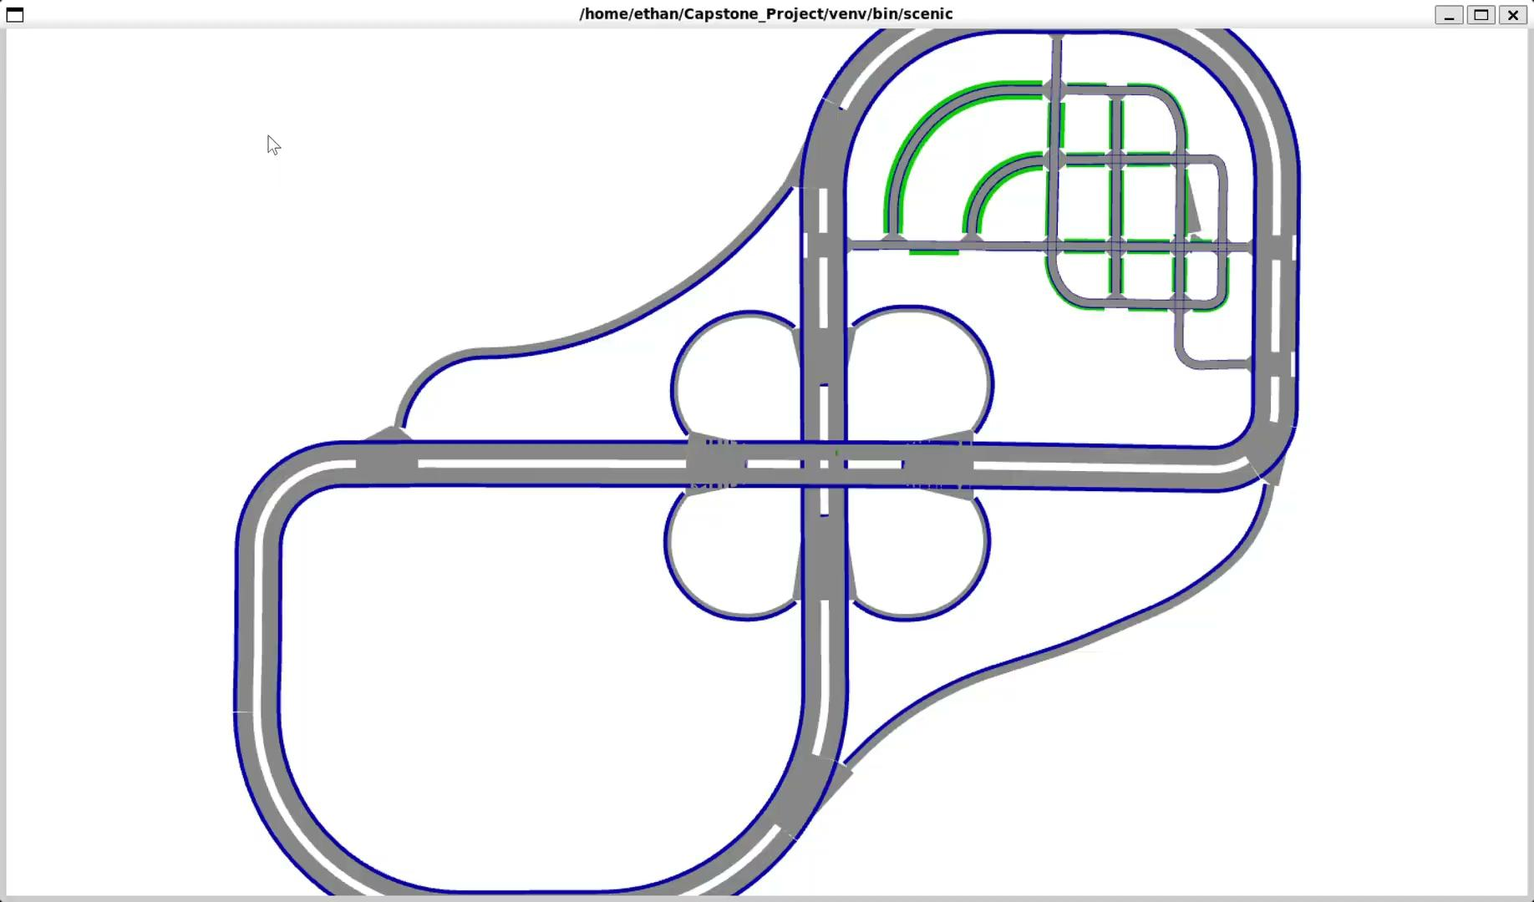
Results/Demo
Carla:
Scenic Mesh:
Notes:
Look at the command to find the camera position, put the camera position really close to the intersection
Maybe add a video to show the dimensions of the road

Slide 16
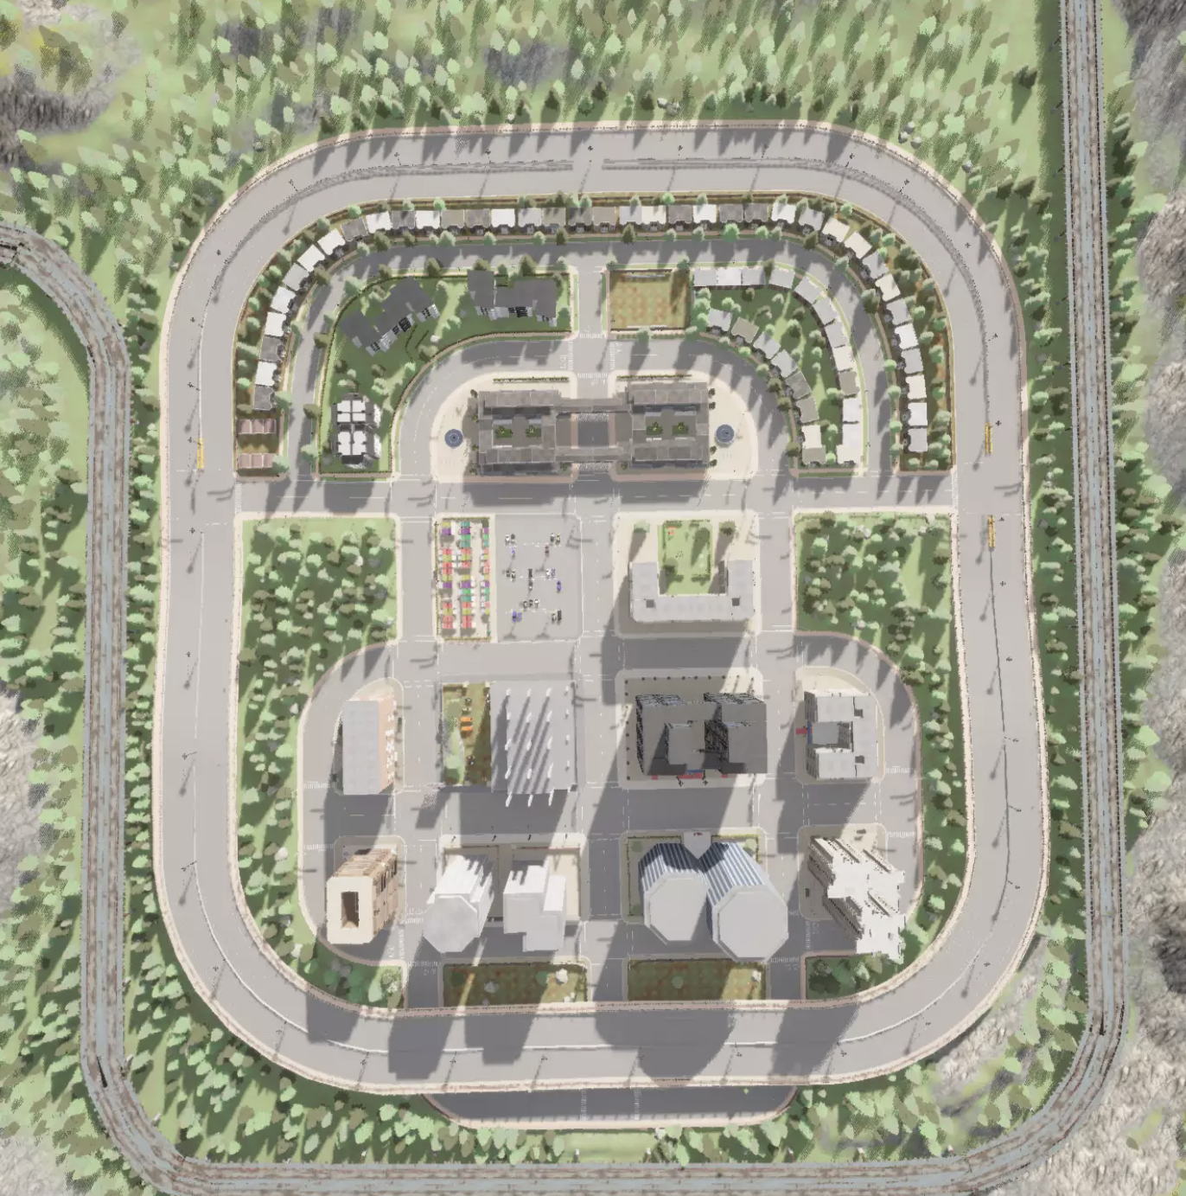

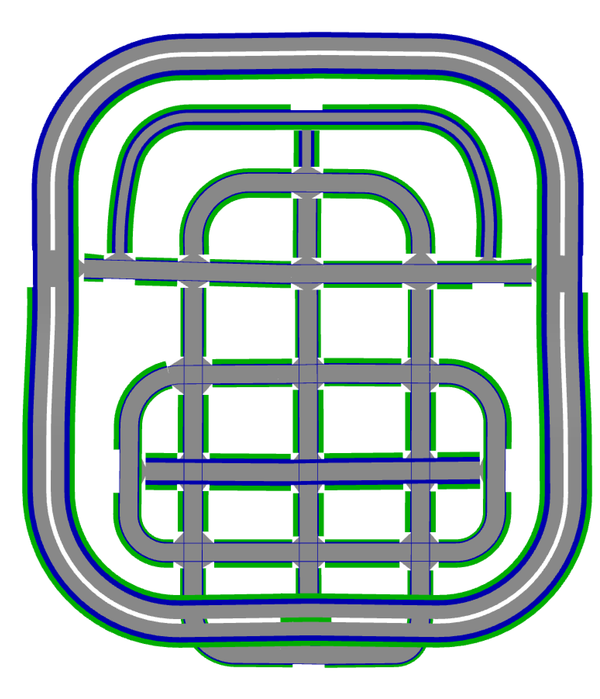
Results/Demo
Carla:
Scenic Mesh:
Notes:
Tilt straight, get better angled picture

Slide 17
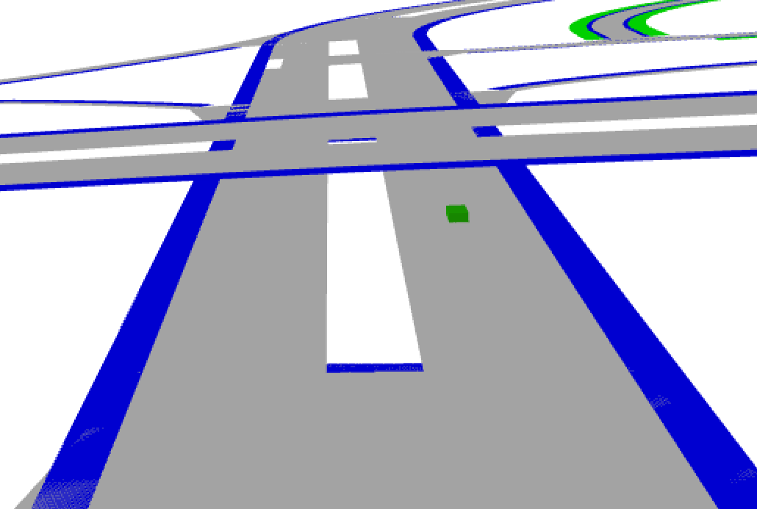
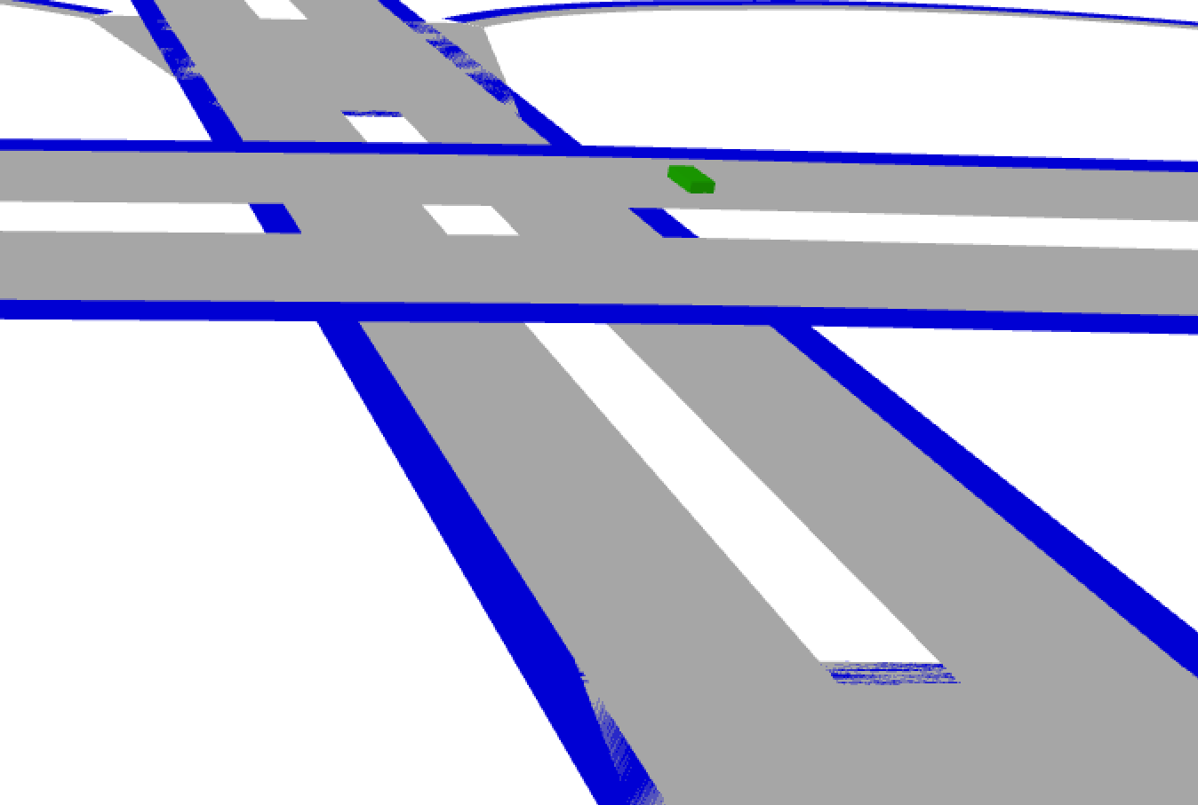
Code
Bottom:
Top:
Bottom:
Top:

Slide 18
Future Work
Fix artifacts with meshes
Shoulders/sidewalks not generating properly
Create visualization of vehicles and other objects
Command line implementation
Currently hard coded into Scenic
Option for 2D polygons
Run more dynamic scenarios
Run on more interesting roads (Parking structure, cylindrical ramp, complex roads)
Super Elevation element
Notes:
Have these appear one by one.

